Slide 1
SML
UNIT-3

Slide 2
K-Nearest Neighbors
K-nearest neighbors (KNN) algorithm
is a type of supervised ML algorithm which can be used for both classification as well as regression predictive problems.
However, it is mainly used for classification predictive problems in industry. The following two properties would define KNN well
Lazy learning algorithm − KNN is a lazy learning algorithm because it does not have a specialized training phase and uses all the data for training while classification.
Non-parametric learning algorithm − KNN is also a non-parametric learning algorithm because it doesn’t assume anything about the underlying data.

Slide 3
K-Nearest Neighbors
The K-NN working can be explained on the basis of the below algorithm:
Step-1: Select the number K of the neighbors
Step-2: Calculate the Euclidean distance of K number of neighbors
Step-3: Take the K nearest neighbors as per the calculated Euclidean distance.
Step-4: Among these k neighbors, count the number of the data points in each category.
Step-5: Assign the new data points to that category for which the number of the neighbor is maximum.
Step-6: Our model is ready.

Slide 4
Working process of KNN Algorithm
K-nearest neighbors (KNN) algorithm uses ‘feature similarity’ to predict the values of new data points which further means that the new data point will be assigned a value based on how closely it matches the points in the training set.
We can understand its working with the help of following steps −
Step 1 − For implementing any algorithm, we need dataset. So during the first step of KNN, we must load the training as well as test data.
Step 2 − Next, we need to choose the value of K i.e. the nearest data points. K can be any integer.

Slide 5
Working process of KNN Algorithm
Step 3 − For each point in the test data do the following −
3.1 − Calculate the distance between test data and each row of training data with the help of any of the method namely: Euclidean, Manhattan or Hamming distance. The most commonly used method to calculate distance is Euclidean.
3.2 − Now, based on the distance value, sort them in ascending order.
3.3 − Next, it will choose the top K rows from the sorted array.
3.4 − Now, it will assign a class to the test point based on most frequent class of these rows.
Step 4 − End

Slide 6
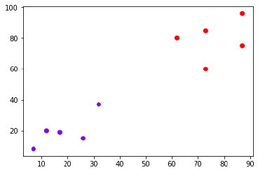
Working of KNN Algorithm with concept of K
Now, we need to classify new data point with black dot (at point 60,60) into blue or red class. We are assuming K = 3 i.e. it would find three nearest data points. It is shown in the next diagram

Slide 7
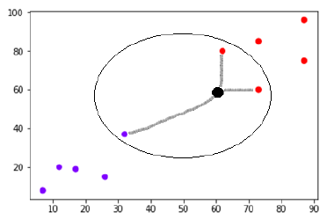
Working of KNN Algorithm with concept of K

Slide 8
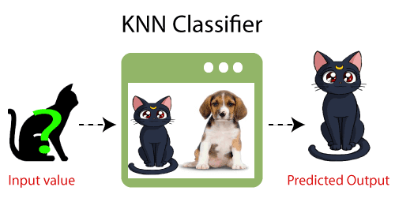
KNN-Simple Example
Suppose, we have an image of a creature that looks similar to cat and dog, but we want to know either it is a cat or dog.
So for this identification, we can use the KNN algorithm, as it works on a similarity measure.
Our KNN model will find the similar features of the new data set to the cats and dogs images and based on the most similar features it will put it in either cat or dog category.

Slide 9
Advantages of KNN
It is very simple algorithm to understand and interpret.
It is very useful for nonlinear data because there is no assumption about data in this algorithm.
It is a versatile algorithm as we can use it for classification as well as regression.
It has relatively high accuracy but there are much better supervised learning models than KNN.

Slide 10
Disadvantages of KNN
It is computationally a bit expensive algorithm because it stores all the training data.
High memory storage required as compared to other supervised learning algorithms.
Prediction is slow in case of big N.
It is very sensitive to the scale of data as well as irrelevant features.

Slide 11
Applications of KNN
The following are some of the areas in which KNN can be applied successfully
Banking System
KNN can be used in banking system to predict weather an individual is fit for loan approval?
Does that individual have the characteristics similar to the defaulters one?
Calculating Credit Ratings
KNN algorithms can be used to find an individual’s credit rating by comparing with the persons having similar traits.
Politics
With the help of KNN algorithms, we can classify a potential voter into various classes like “Will Vote”, “Will not Vote”, “Will Vote to Party ‘Congress’, “Will Vote to Party ‘BJP’.
Other areas in which KNN algorithm can be used are Speech Recognition, Handwriting Detection, Image Recognition and Video Recognition.

Slide 12
KNN voter example
Objective is to predict the party for which voter will vote based on their neighborhood, precisely geolocation (latitude and longitude).
Here we assume that we can identify the potential voter to which political party they would be voting based on majority voters did voted for that particular party in that vicinity, so that they have high probability to vote for the majority party.
However,
tuning the k-value
(number to consider, among which majority should be counted)
is the milliondollar question
(as same as any machine learning algorithm):

Slide 13
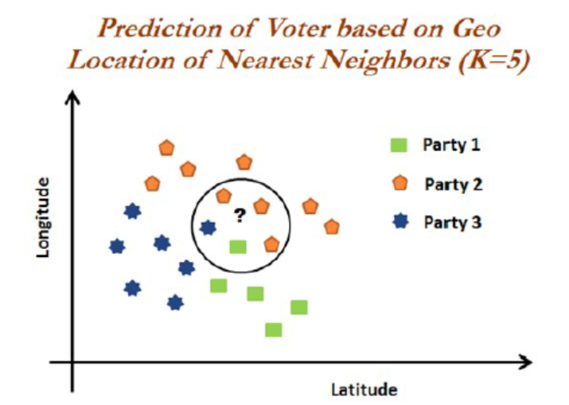
KNN voter example

Slide 14
KNN voter example
Party 2- As within the vicinity, one neighbor has voted for Party 1 and the other voter voted for Party 3.
But three voters voted for Party 2.
In fact, by this way KNN solves any given classification problem.
Regression problems are solved by taking mean of its neighbors within the given circle or vicinity or k-value.

Slide 15
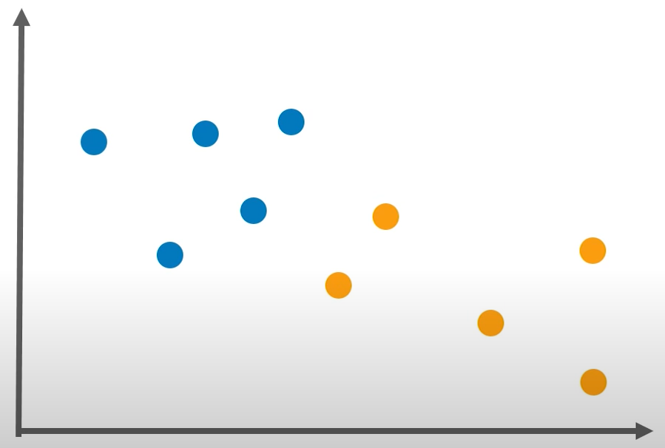
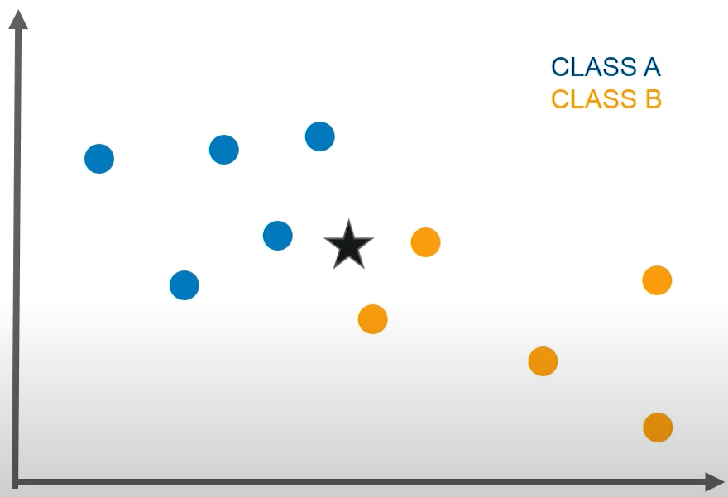
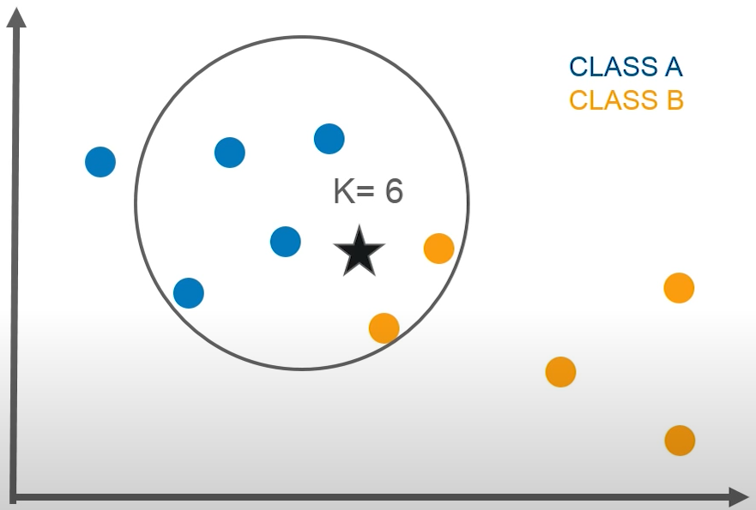
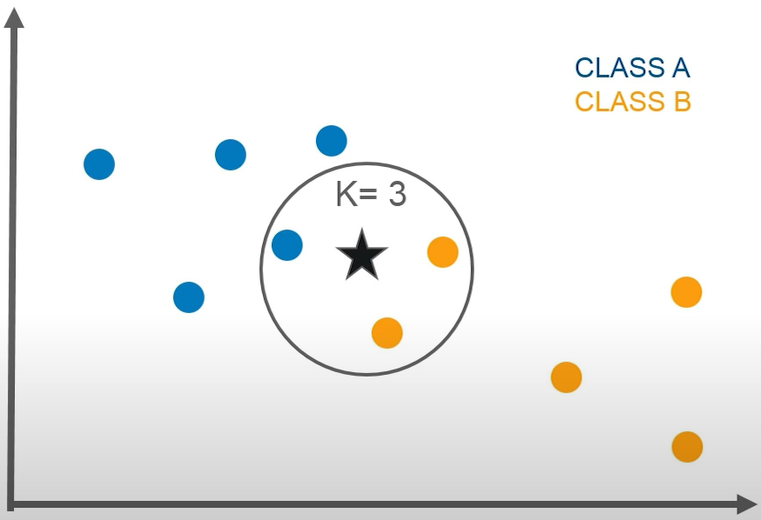
How does KNN Algorithm works ?

Slide 16
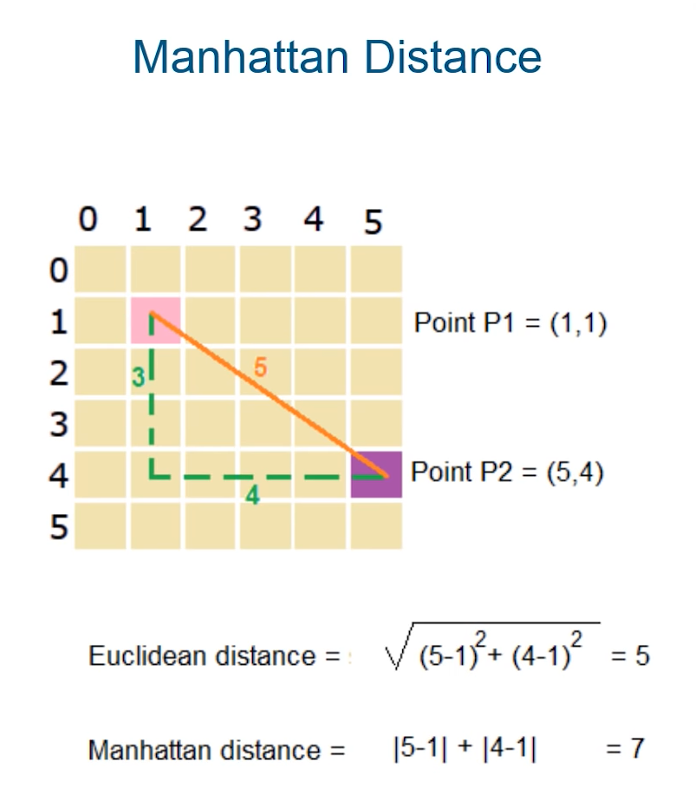
How does KNN Algorithm works ?

Slide 17
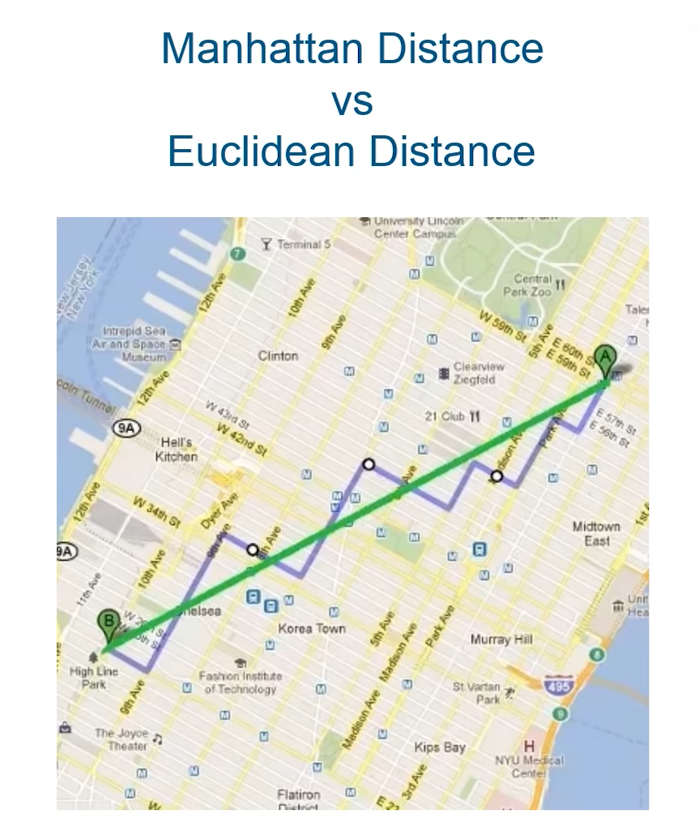
How does KNN Algorithm works ?

Slide 18
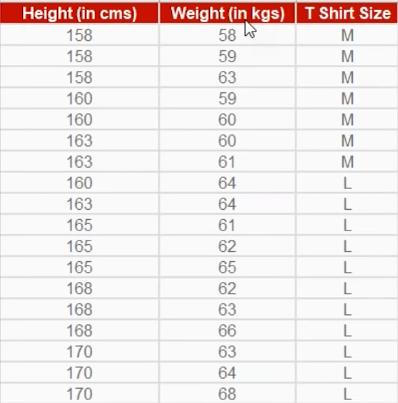
KNN- Example:

Slide 19
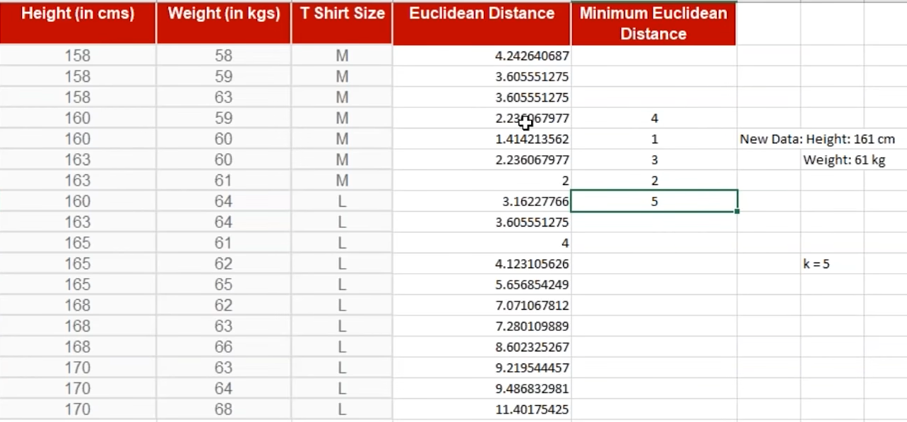
KNN- Example:

Slide 20
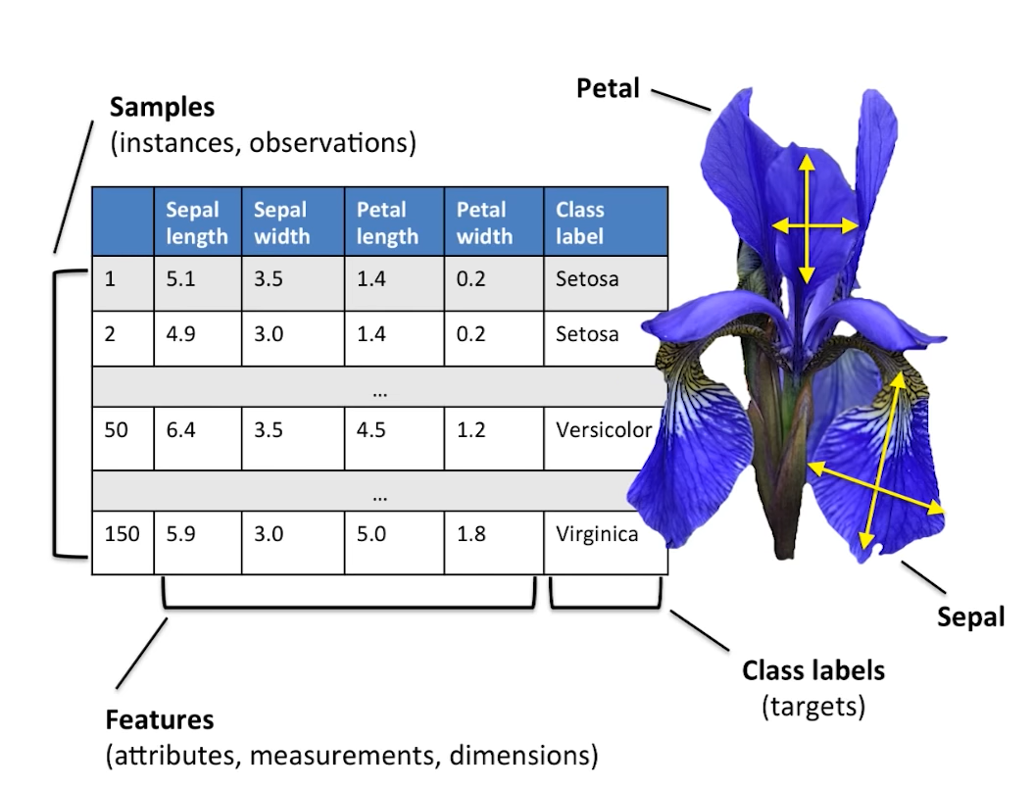
KNN- IRIS (Dataset)

Slide 21
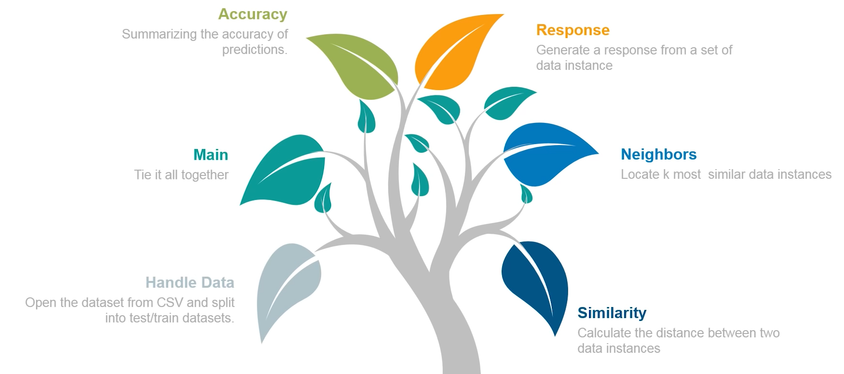
KNN- Process Steps

Slide 22
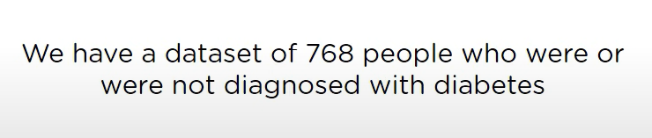
USE-CASE (Predict Diabetes)

Slide 23
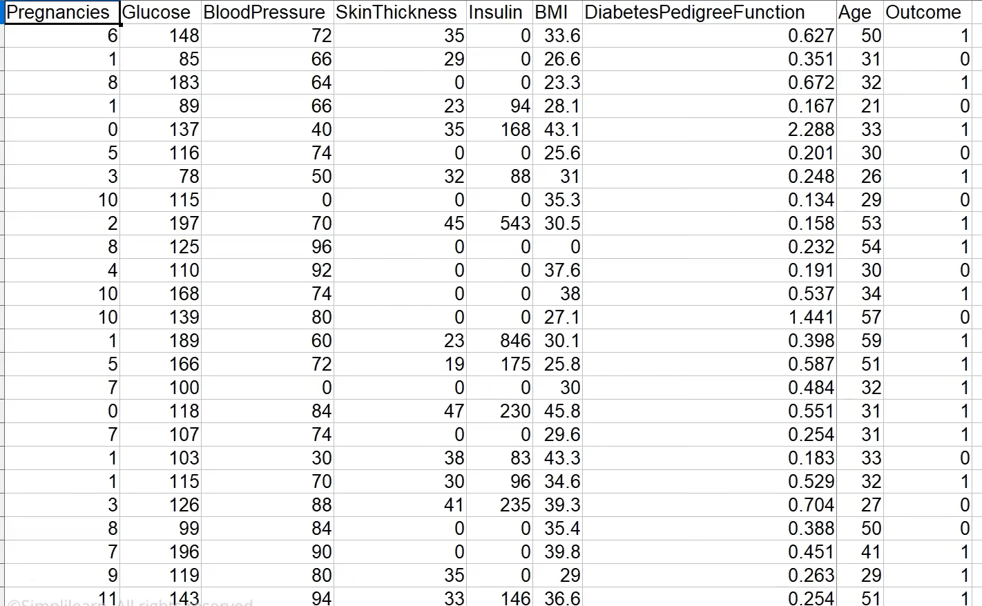
Diabetes- Dataset

Slide 24
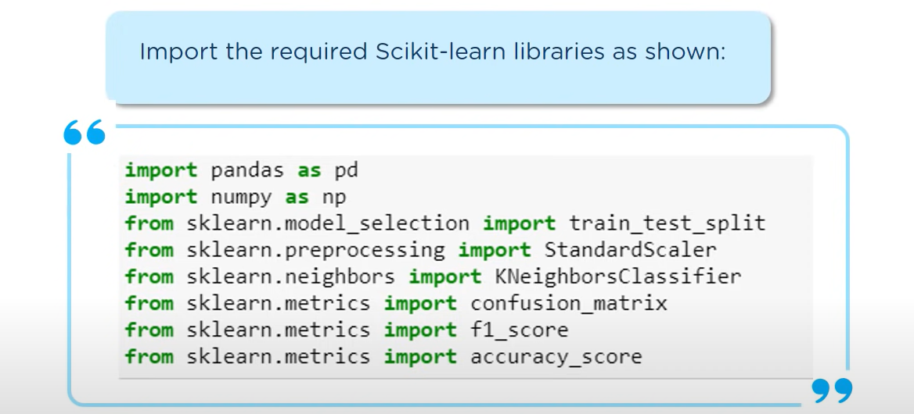
Implementation - Predict Diabetes

Slide 25
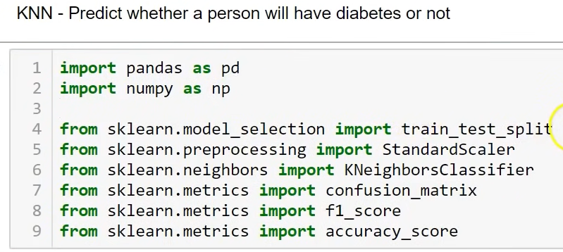
Import Libraries

Slide 26
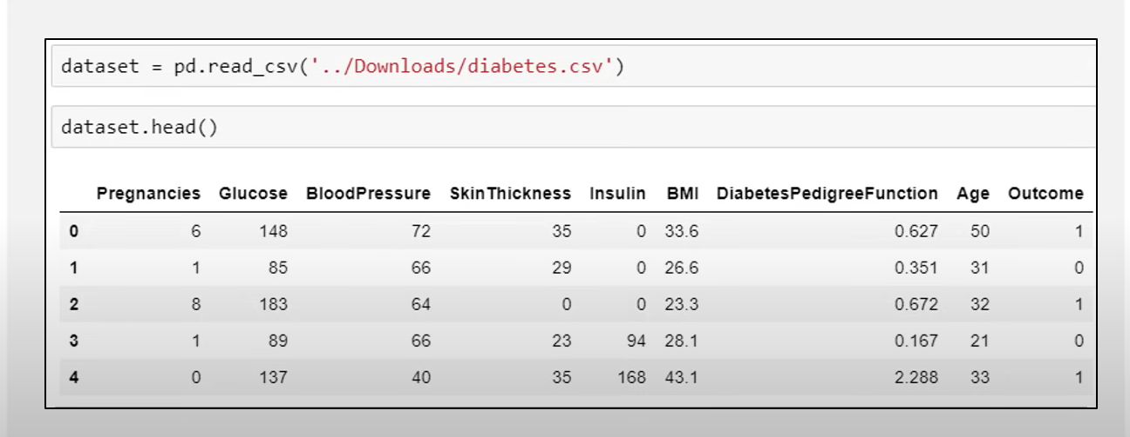
Load Dataset

Slide 27
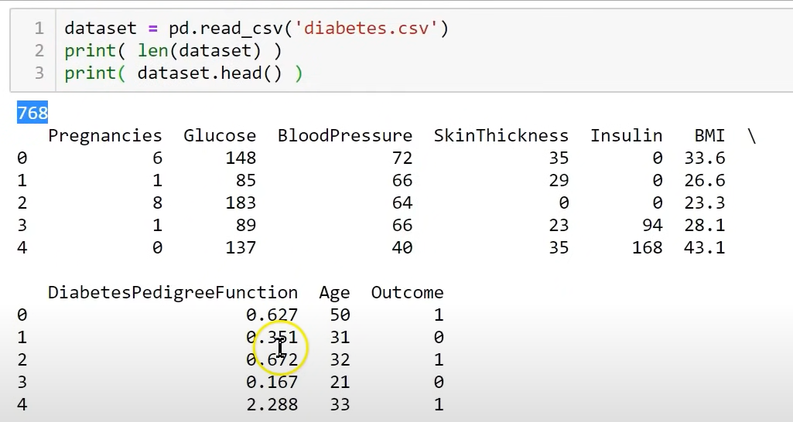
Load Dataset

Slide 28
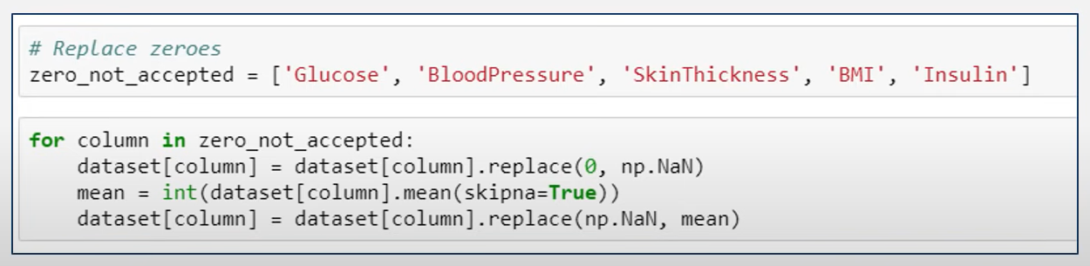

Slide 29
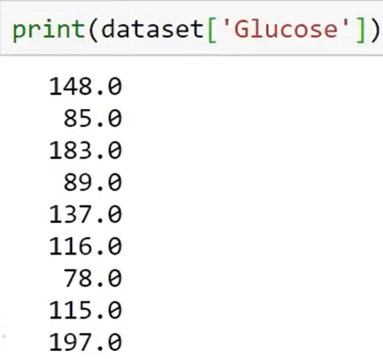
List out Glucose Feature in a Dataset

Slide 30
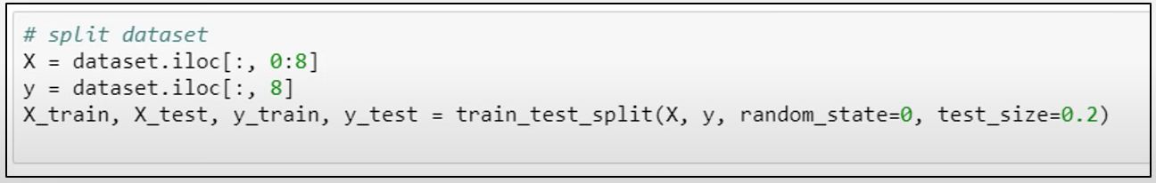

Slide 31
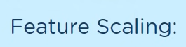
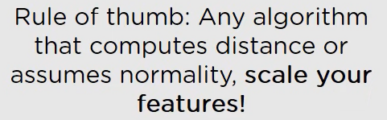
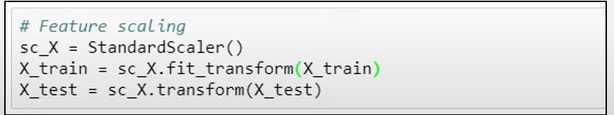

Slide 32
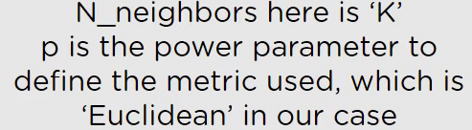

Slide 33
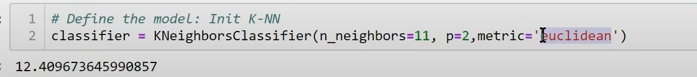
KNN Classifier Model

Slide 34
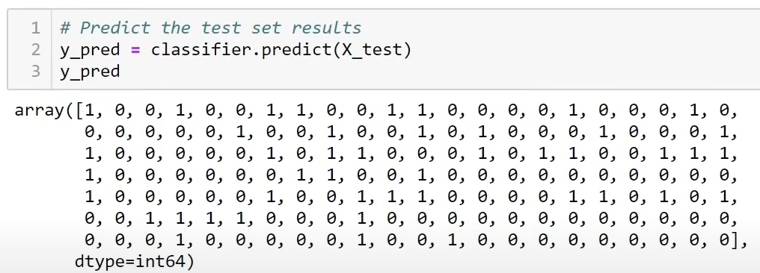
Predict Test

Slide 35
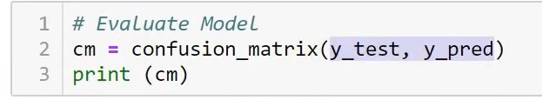
Evaluate Model

Slide 36
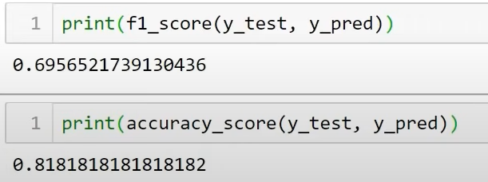
F1 Score and Accuracy

Slide 37
Curse of dimensionality
KNN completely depends on distance.
Studying about the curse of dimensionality to understand when KNN deteriorates its predictive power with the increase in number of variables required for prediction.
Though there are many ways to check the curve of dimensionality, here we are using uniform random values between zero and one generated for 1D, 2D, and 3D space to validate this hypothesis.
mean distance between 1,000 observations have been calculated with the change in dimensions.
increase in dimensions, distance between points increases logarithmically, which gives us the hint that we need to have exponential increase in data points with increase in dimensions in order to make machine learning algorithms

Slide 38
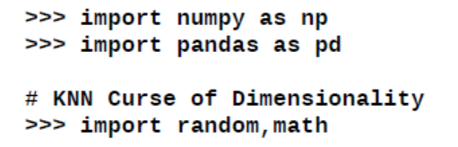
Curse of dimensionality
mean distance between 1,000 observations have been calculated with the change in dimensions.
It is apparent that with the increase in dimensions, distance between points increases logarithmically, which gives us the hint that we need to have exponential increase in data points with increase in dimensions in order to make machine learning algorithms work correctly:

Slide 39
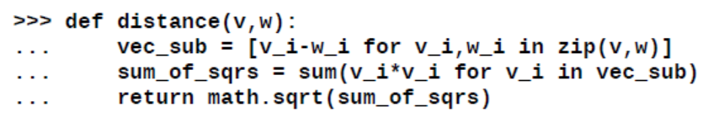
Curse of dimensionality

Slide 40
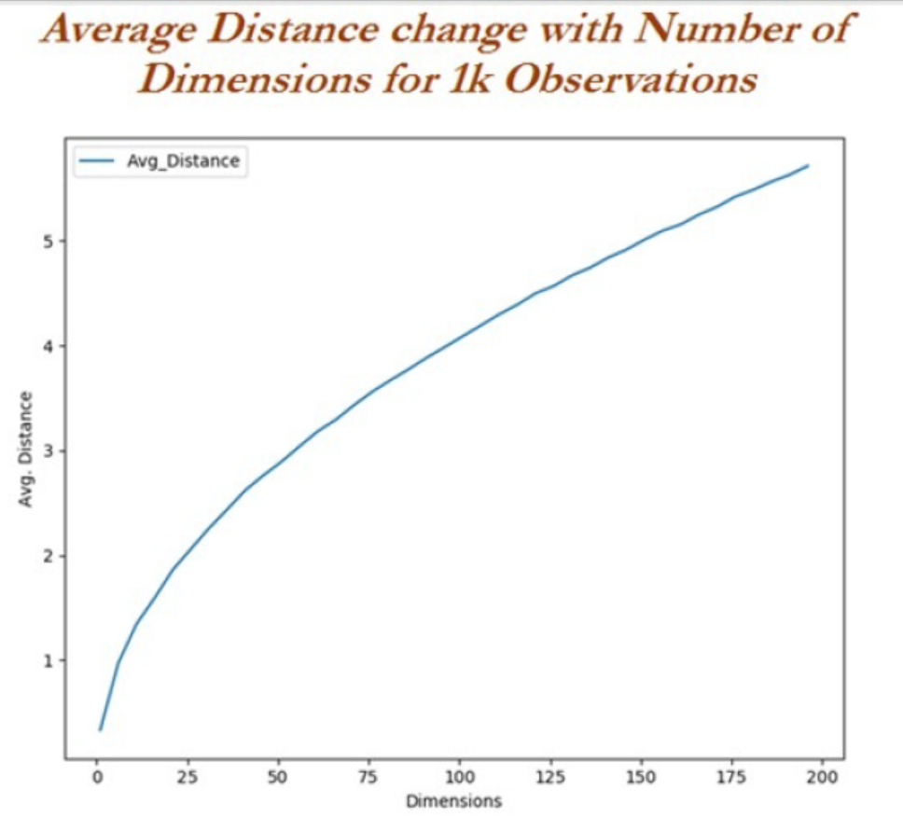
Curse of dimensionality

Slide 41
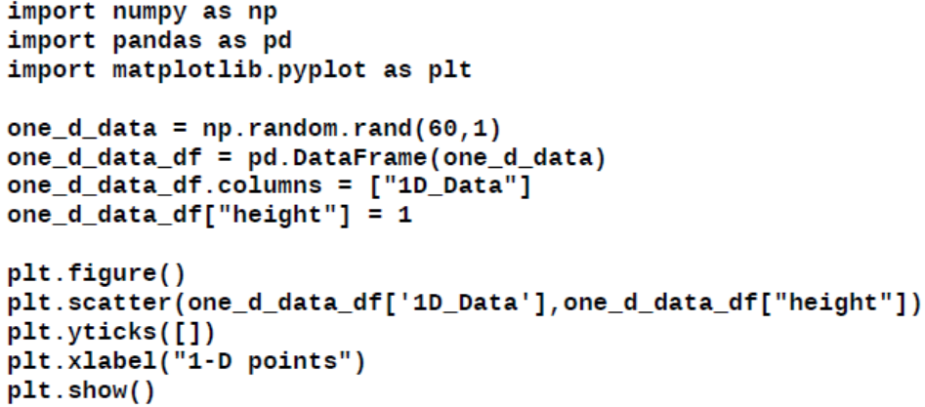
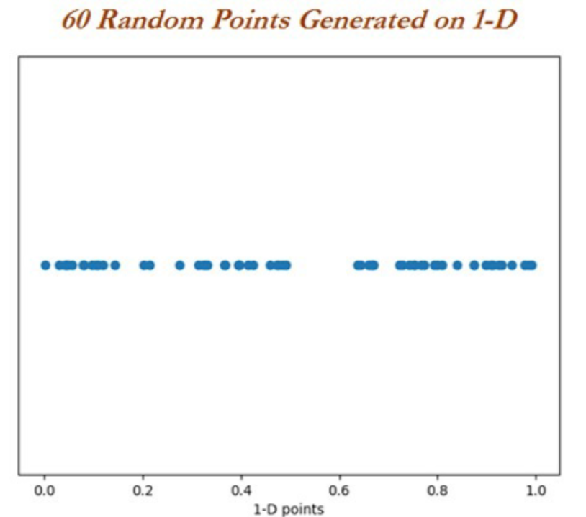
Curse of dimensionality with 1D, 2D, and 3D example
A quick analysis has been done to see how distance 60 random points are expanding with the increase in dimensionality. Initially random points are drawn for one-dimension:

Slide 42
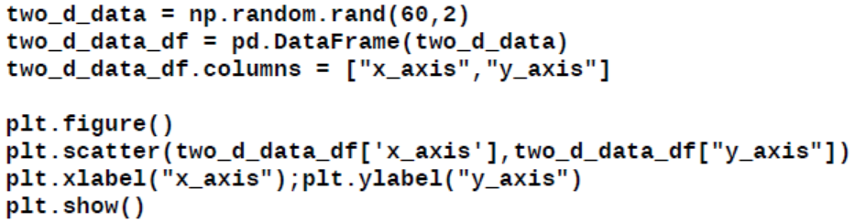
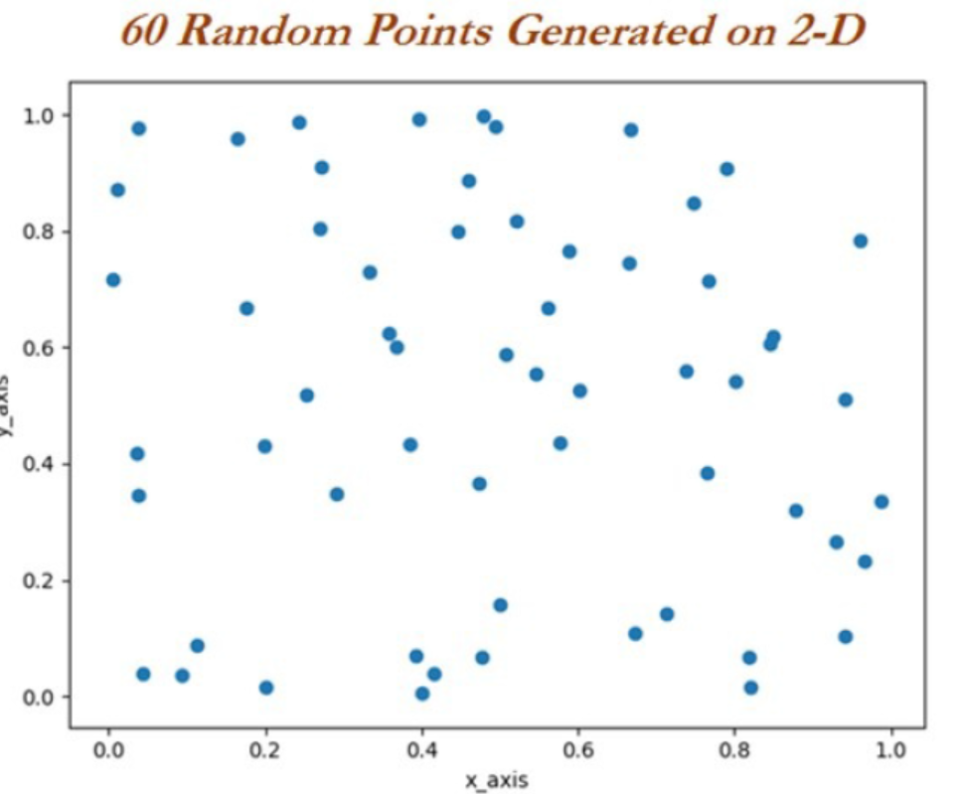
2-D Plot

Slide 43
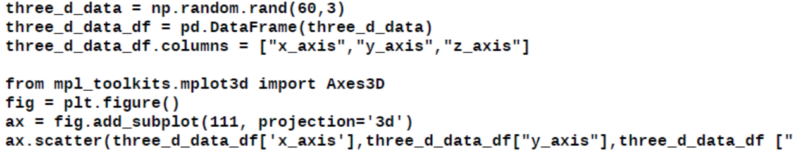
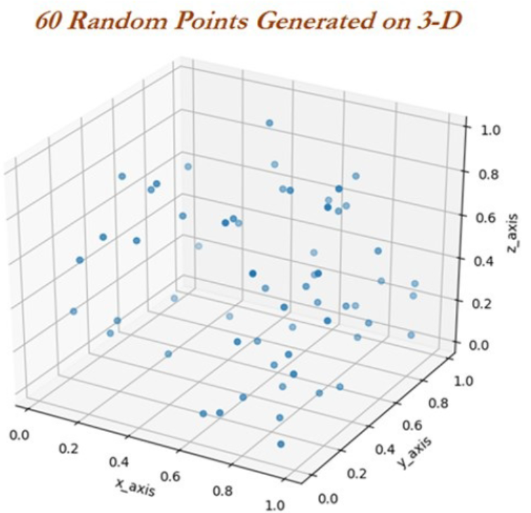
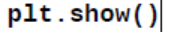
3-D Plot

Slide 44
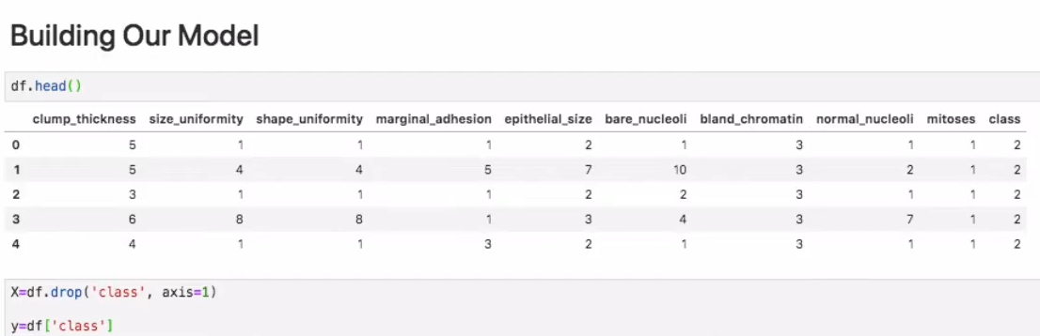
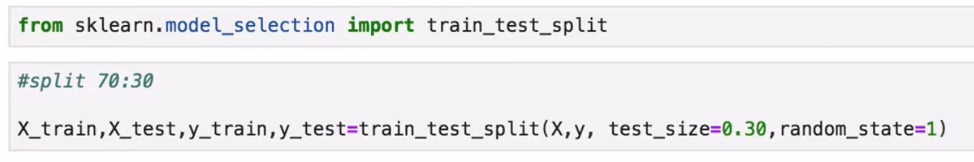

Slide 45
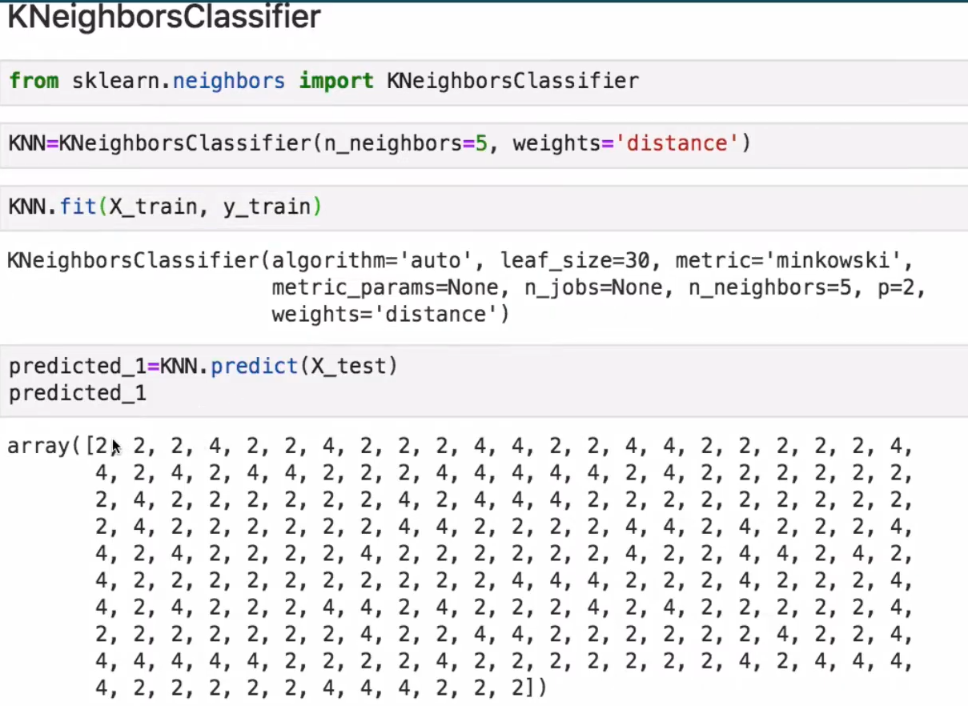

Slide 46
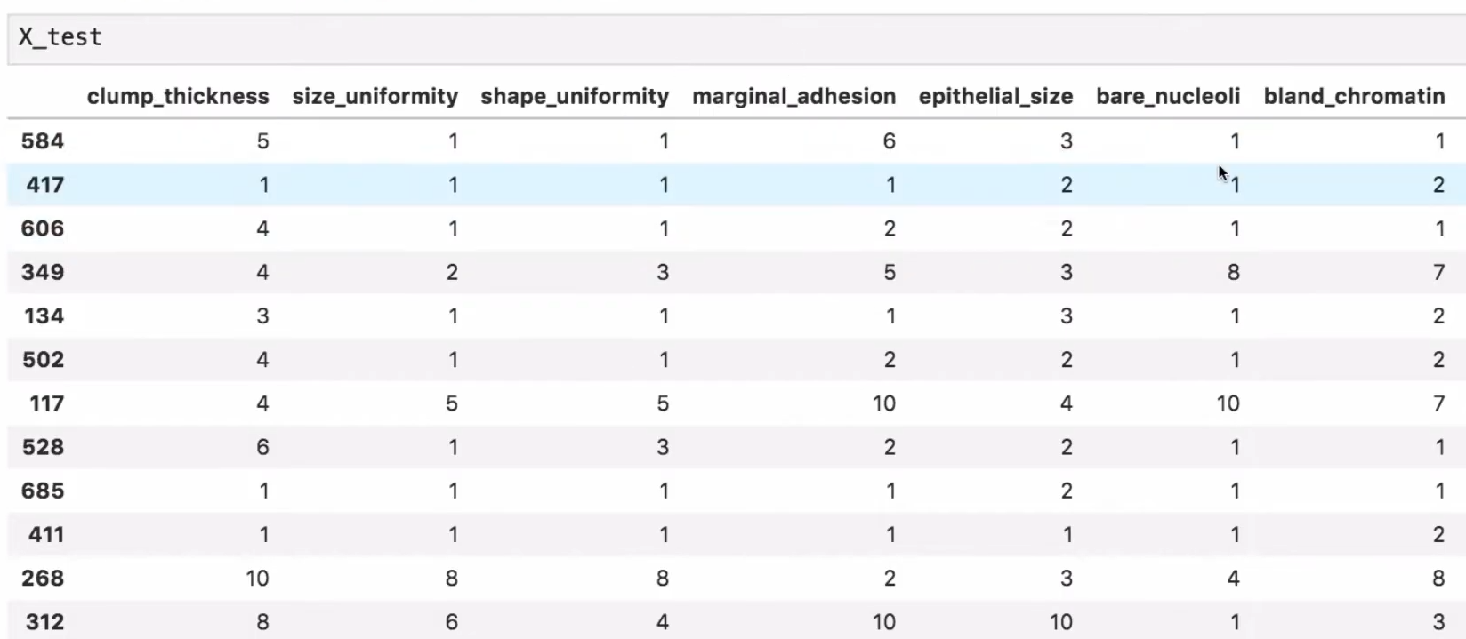

Slide 47
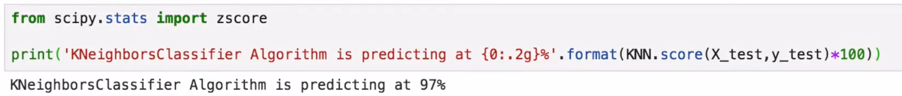

Slide 48
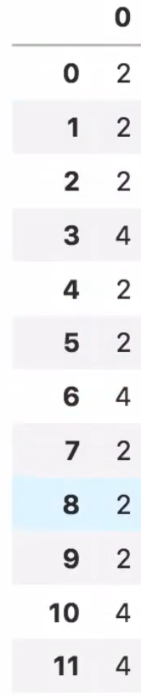
KNN-Predictions
knnPredictions=pd.DataFrame(predicted_1)
df1=pd.([knnPredictions], axis =1)
df1

Slide 49
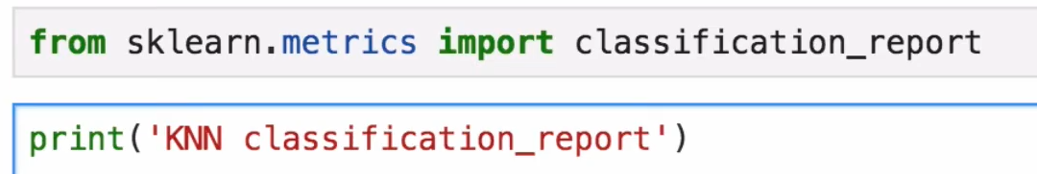

Slide 50
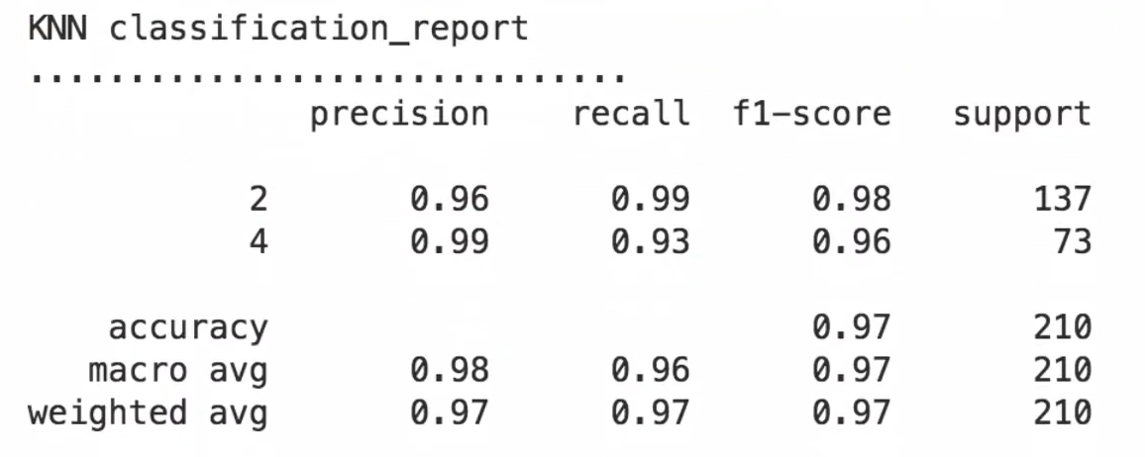

Slide 51
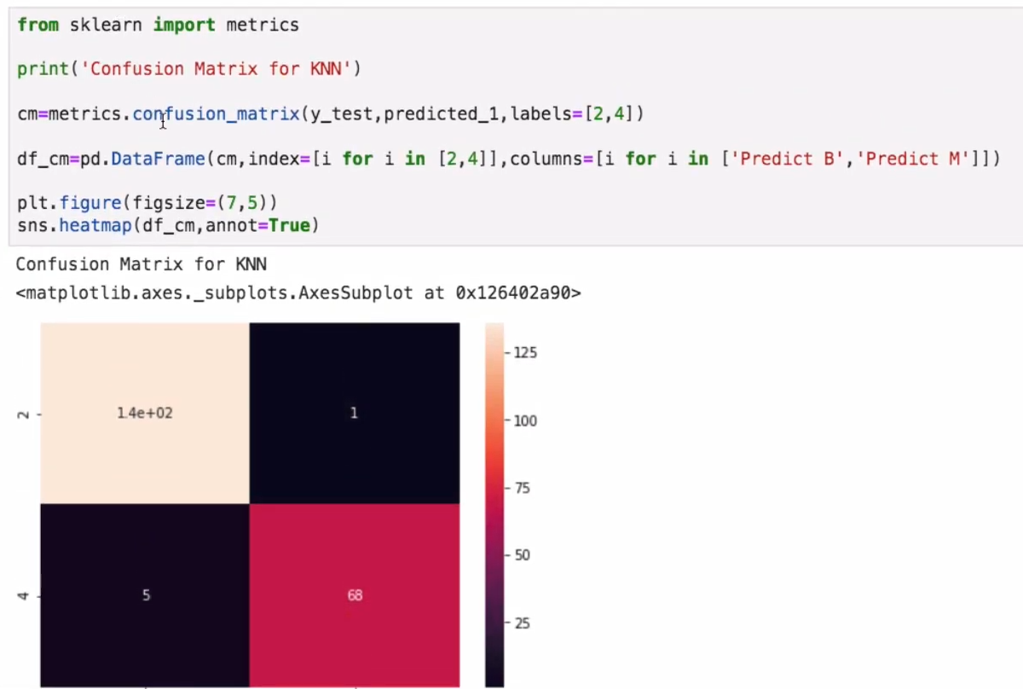

Slide 52
Naive Bayes
Foundational mathematical principles for determining the probability of unknown events from the known events.
Example:
if all apples are red in color and average diameter would be about 4 inches then, if at random one fruit is selected from the basket with red color and diameter of 3.7 inch
what is the probability that the particular fruit would be an apple?
here would be no dependency between color and diameter.
independence assumption makes the Naive Bayes classifier most effective in terms of computational ease for particular tasks such as email classification based on words in which high dimensions of vocab do exist, even after assuming independence between features.

Slide 53
Naive Bayes
Bayesian classifiers are best applied to problems in which information from a very high number of attributes should be considered simultaneously to estimate the probability of final outcome.
Bayesian methods utilize all available evidence to consider for prediction even features have weak effects on the final outcome to predict.
However, we should not ignore the fact that a large number of features with relatively minor effects, taken together its combined impact would form strong classifiers

Slide 54
Probability Fundamentals
Probability of an event can be estimated from observed data by dividing the number of trails in which an event occurred with total number of trails.
If a bag contains red and blue balls and randomly picked 10 balls one
by one with replacement and out of 10, 3 red balls appeared in trails
we can say that probability of red is 0.3,
pred = 3/10 = 0.3.
Total probability of all possible outcomes must be 100 percent.

Slide 55
Probability Fundamentals
If a trail has two outcomes such as email classification either it is spam or not spam and both cannot occur simultaneously, these events are considered as mutually exclusive with each other.
In addition, if those outcomes cover all possible events, it would be called as exhaustive events.
For example,
In Email classification if P (spam) = 0.1.
we will be able to calculate P (ham) = 1- 0.1 = 0.9, these two events are mutually exclusive. In the following Venn diagram, all the email possible classes are represented (the entire universe) with type of outcomes.

Slide 56
Probability Fundamentals
For example, in email
classification if P (spam) = 0.1, we will be able to calculate P (ham) = 1- 0.1 = 0.9, these two events are mutually exclusive.
In the following Venn diagram, all the email possible classes are represented (the entire universe) with type of outcomes:

Slide 57


Slide 58
Joint probability
Though mutually exclusive cases are simple to work upon, most of the actual problems do fall under the category of non-mutually exclusive events.
By using the joint appearance, we can predict the event outcome.
Example:
if emails messages present the word like lottery, which is very highly likely of being spam rather than ham.

Slide 59

Joint probability
The following Venn diagram indicates the joint probability of spam with lottery.
However, if you notice in detail, lottery circle is not contained completely within the spam circle.
This implies that not all spam messages contain the word lottery and not every email with the word lottery is spam.

Slide 60


Slide 61
Joint probability
In case if both the events are totally unrelated, they are called independent events and their respective value is
p(spam ∩ lottery) = p(spam) * p(lottery) = 0.1 * 0.04 = 0.004,
which is 0.4 percent of all messages are spam containing the word Lottery.
In general, for independent events P(A∩ B) = P(A)* P(B).

Slide 62

Understanding Bayes theorem with conditional probability
Conditional probability provides a way of calculating relationships between dependent events using Bayes theorem
For example, A and B are two events and
we would like to calculate P(A\B) can be read as the probability of event occurring A given the fact that event B already occurred, in fact this is known as conditional probability

Slide 63
Understanding Bayes theorem with conditional probability
we will now talk about the email classification example.
Our objective is to predict whether email is spam given the word lottery and some other clues.
In this case we already knew the overall probability of spam, which is 10 percent also known as prior probability.
Now suppose you have obtained an additional piece of information that probability of word lottery in all messages, which is 4 percent, also known as marginal likelihood

Slide 64

Understanding Bayes theorem with conditional probability
We know the probability that lottery was used in previous spam messages and is called the likelihood.

Slide 65

Understanding Bayes theorem with conditional probability

Slide 66
Naive Bayes classification
Let us construct the likelihood table for the appearance of the three words (W1, W2, and W3), as shown in the following table for 100 emails:

Slide 67
Naive Bayes classification
Problem 1 Consider a set of patients coming for treatment in a certain clinic. Let A denote the event that a “Patient has liver disease” and B the event that a “Patient is an alcoholic.” It is known from experience that 10% of the patients entering the clinic have liver disease and 5% of the patients are alcoholics. Also, among those patients diagnosed with liver disease, 7% are alcoholics. Given that a patient is alcoholic, what is the probability that he will have liver disease?
Solution Using the notations of probability, we have
P(A) = 10% = 0.10
P(B) = 5% = 0.05
P(B∣A) = 7% = 0.07
P(A∣B) = P(B∣A)P(A)
P(B) = 0.07 × 0.10 0.05 = 0.14

Slide 68
Naive Bayes classification
Problem 2 Three factories A, B, C of an electric bulb manufacturing company produce respectively 35%. 35% and 30% of the total output. Approximately 1.5%, 1% and 2% of the bulbs produced by these factories are known to be defective. If a randomly selected bulb manufactured by the company was found to be defective, what is the probability that the bulb was manufactures in factory A?

Slide 69

Naive Bayes classification

Slide 70

Naive Bayes classification

Slide 71

Naive Bayes classification

Slide 72


Naive Bayes classification

Slide 73

Naive Bayes classification

Slide 74

Naive Bayes classification

Slide 75

Naive Bayes classification

Slide 76

Naive Bayes classification

Slide 77

Naive Bayes classification

